Slide 1
File Organization
Dr. M. Brindha
Assistant Professor
Department of CSE
NIT, Trichy-15

Slide 2
File Organization
The database is stored as a collection of files. Each file is a sequence of records. A record is a sequence of fields.
One approach:
assume record size is fixed
each file has records of one particular type only
different files are used for different relations
This case is easiest to implement; will consider variable length records later.

Slide 3
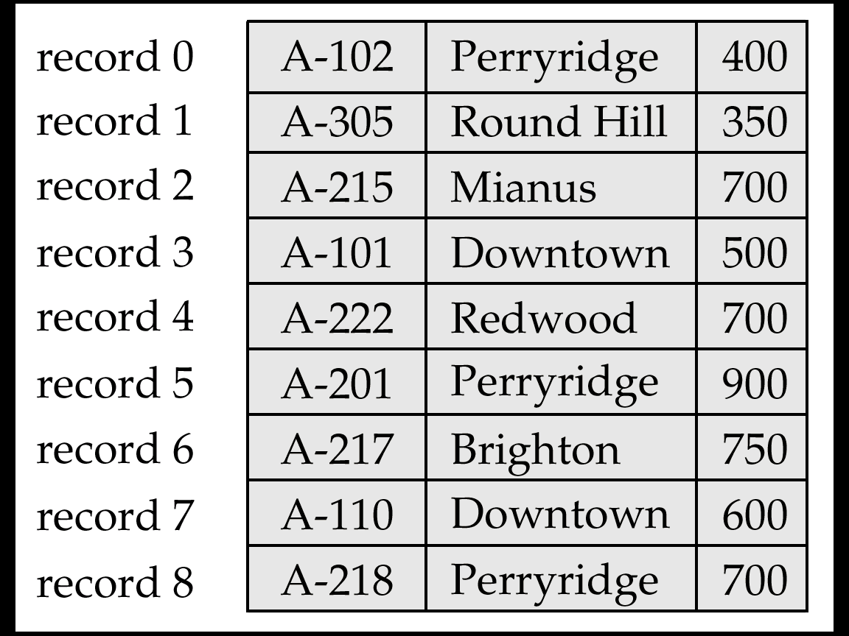
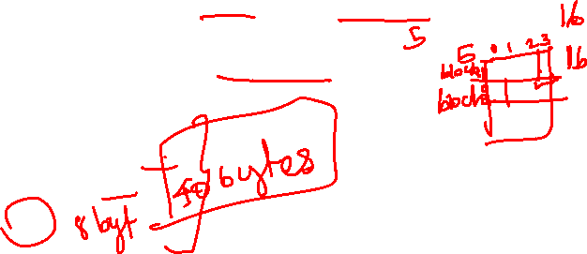
Fixed-Length Records
Simple approach:
Store record i starting from byte n ∗ (i – 1), where n is the size of each record.
Record access is simple but records may cross blocks
Modification: do not allow records to cross block boundaries
type account=record
account-number: char(10);
branch-name: char(22);
balance: real;
End
Problems:
1. Deletion
2. Some records cross block boundaries
Deletion of record I: alternatives:
move records i + 1, . . ., n to i, . . . , n – 1
move record n to i
do not move records, but link all free records on a free list

Slide 4

File Containing account Records

Slide 5
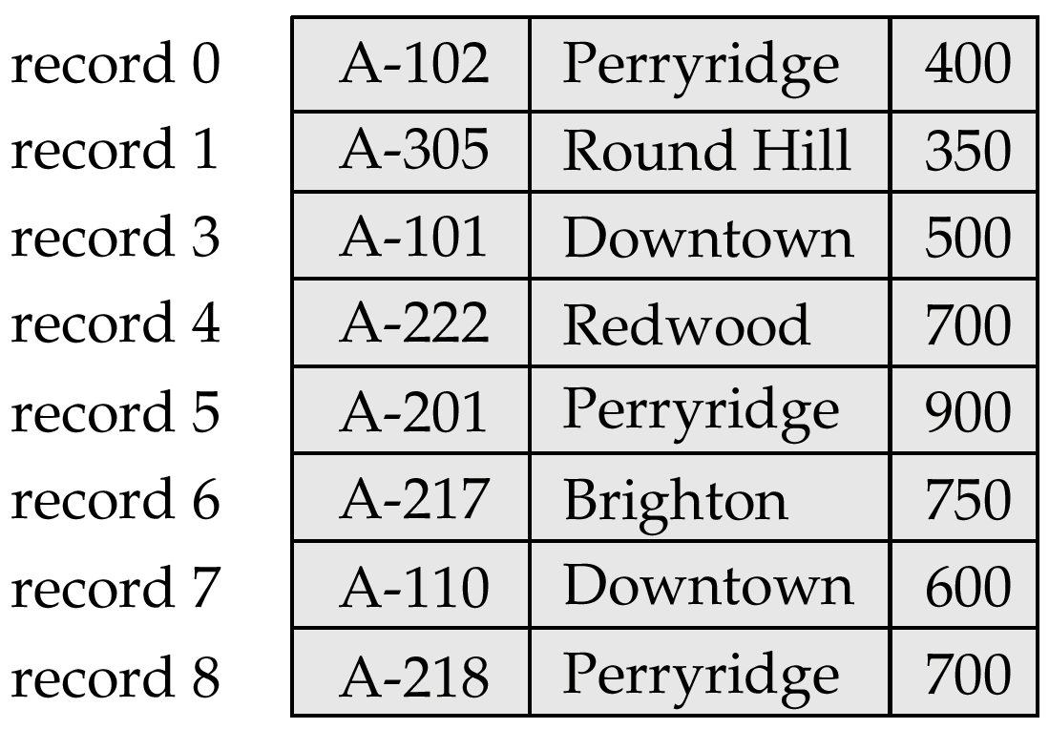
Record 2 Deleted and All Records Moved

Slide 6
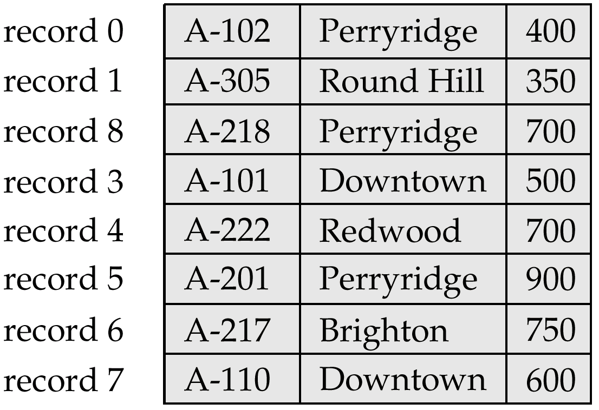
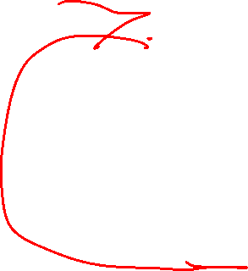
With Record 2 deleted and Final Record Moved

Slide 7
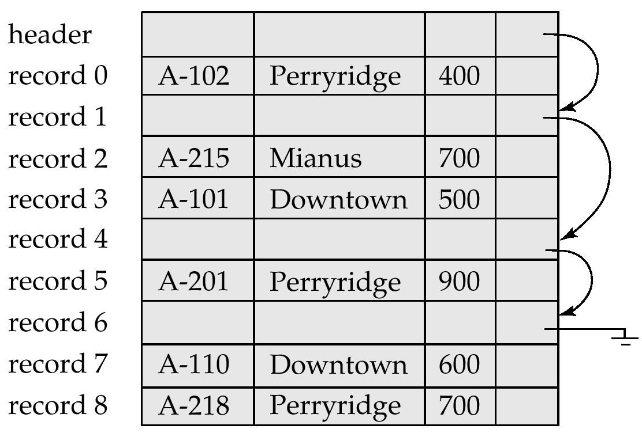

Free Lists
Store the address of the first deleted record in the file header.
Use this first record to store the address of the second deleted record, and so on
Can think of these stored addresses as pointers since they “point” to the location of a record.
More space efficient representation: reuse space for normal attributes of free records to store pointers. (No pointers stored in in-use records.)

Slide 8
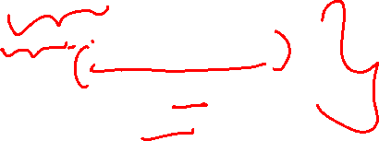
Variable-Length Records
Variable-length records arise in database systems in several ways:
Storage of multiple record types in a file.
Record types that allow variable lengths for one or more fields.
Record types that allow repeating fields (used in some older data models).
type account-list=record
branch-name: char(22);
account-info: array[1…∞] of record;
account-number: char(10);
balance: real;
end
end
Byte string representation
Attach an end-of-record (⊥) control character to the end of each record
Difficulty with deletion
Difficulty with growth

Slide 9
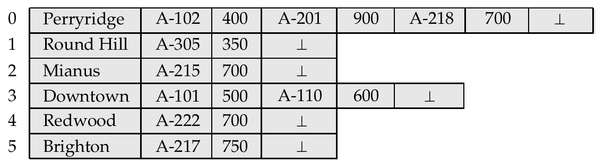
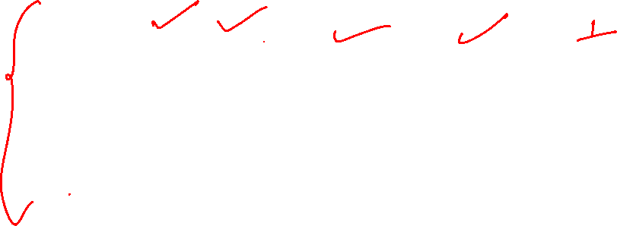
Byte-String Representation of Variable-Length Records

Slide 10
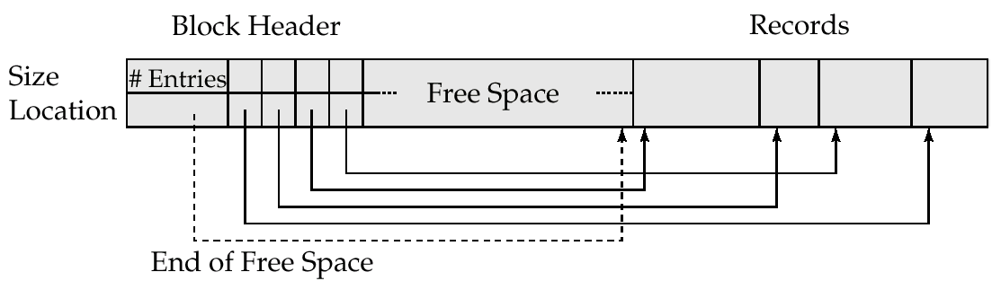
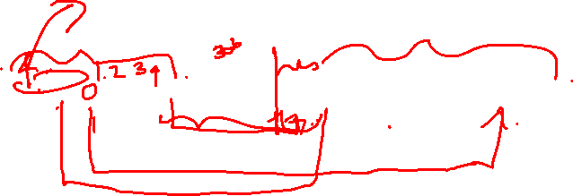
Variable-Length Records: Slotted Page Structure
Slotted page header contains:
number of record entries
end of free space in the block
location and size of each record
Records can be moved around within a page to keep them contiguous with no empty space between them; entry in the header must be updated.
Pointers should not point directly to record — instead they should point to the entry for the record in header.

Slide 11
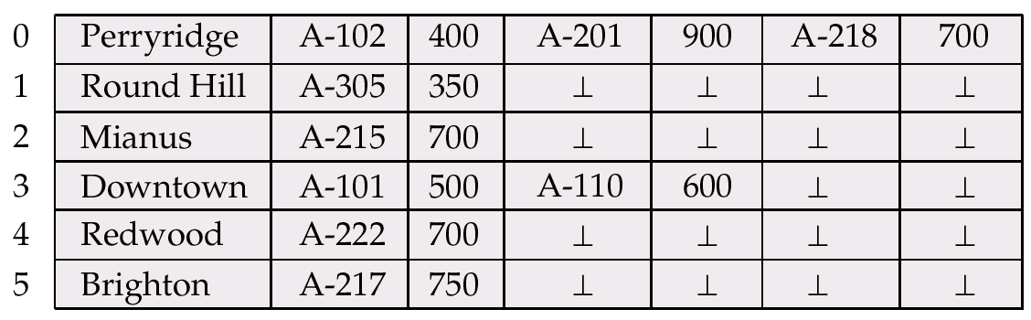

Variable-Length Records (Cont.)
Fixed-length representation:
reserved space
pointers
Reserved space – can use fixed-length records of a known maximum length; unused space in shorter records filled with a null or end-of-record symbol.

Slide 12
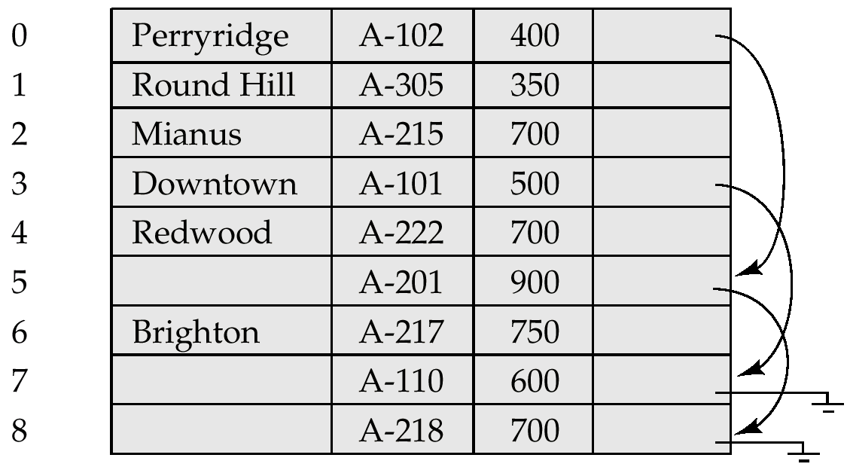
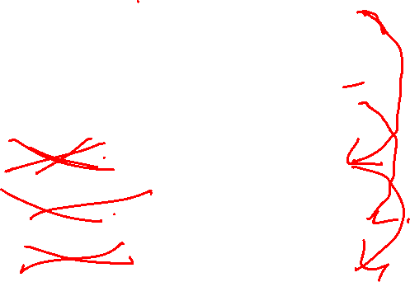
Pointer Method
Pointer method
A variable-length record is represented by a list of fixed-length records, chained together via pointers.
Can be used even if the maximum record length is not known

Slide 13
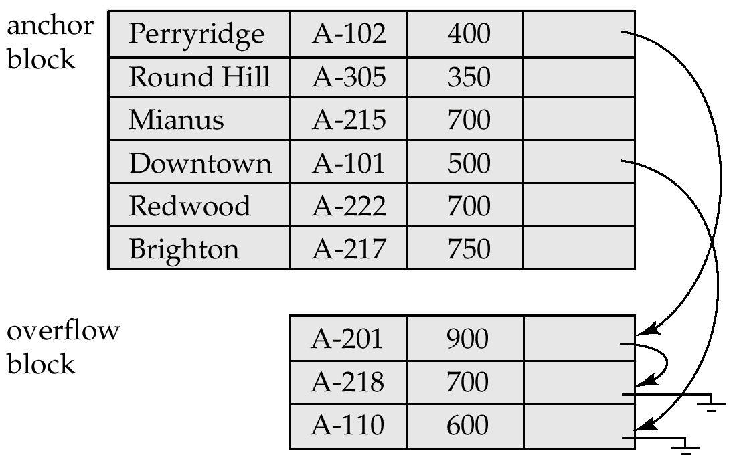
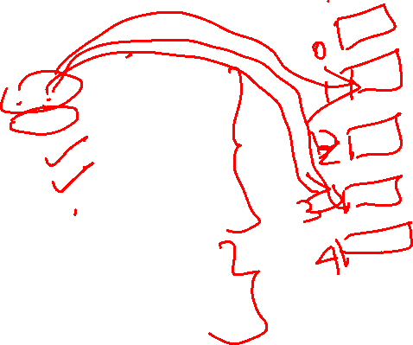
Pointer Method (Cont.)
Disadvantage to pointer structure; space is wasted in all records except the first in a a chain.
Solution is to allow two kinds of block in file:
Anchor block – contains the first records of chain
Overflow block – contains records other than those that are the first records of chairs.

Slide 14
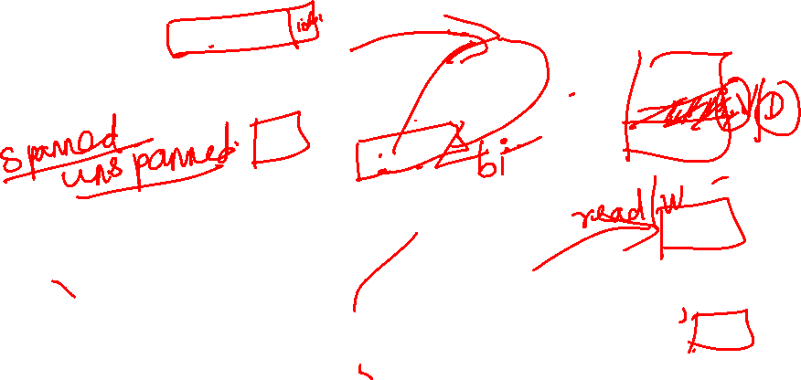
Organization of Records in Files
Heap – a record can be placed anywhere in the file where there is space
Sequential – store records in sequential order, based on the value of the search key of each record
Hashing – a hash function computed on some attribute of each record; the result specifies in which block of the file the record should be placed
Records of each relation may be stored in a separate file. In a clustering file organization records of several different relations can be stored in the same file
Motivation: store related records on the same block to minimize I/O

Slide 15
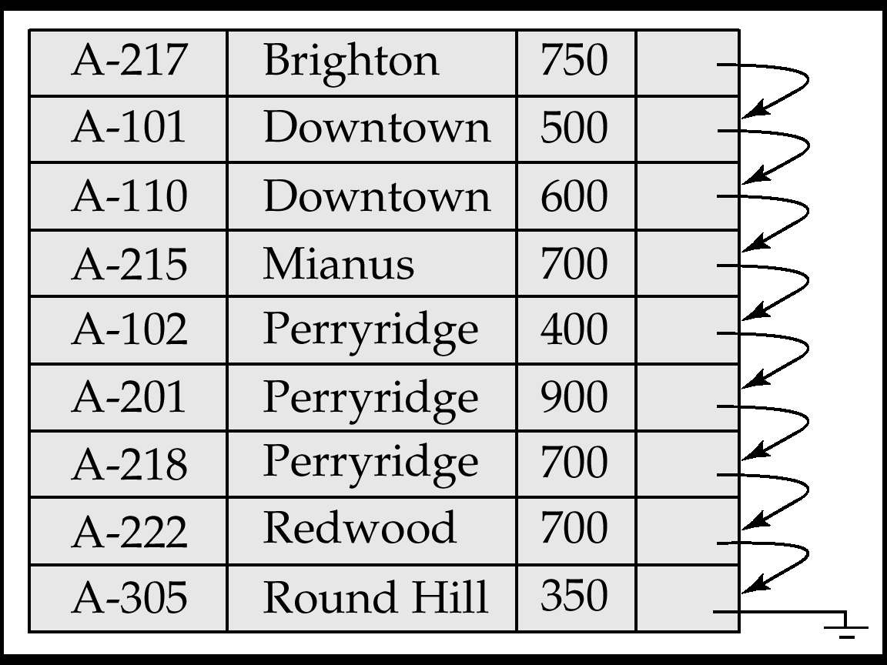
Sequential File Organization
Suitable for applications that require sequential processing of the entire file
The records in the file are ordered by a search-key

Slide 16
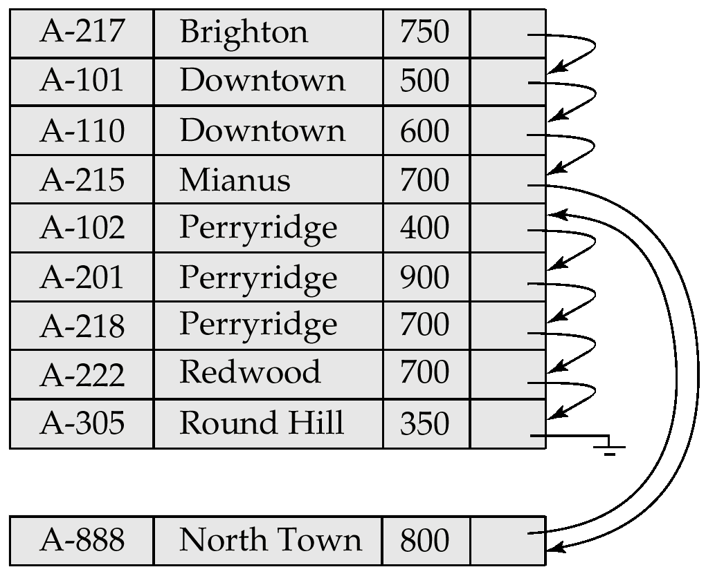

Sequential File Organization (Cont.)
Deletion – use pointer chains
Insertion –locate the position where the record is to be inserted
if there is free space insert there
if no free space, insert the record in an overflow block
In either case, pointer chain must be updated
Need to reorganize the file from time to time to restore sequential order

Slide 17
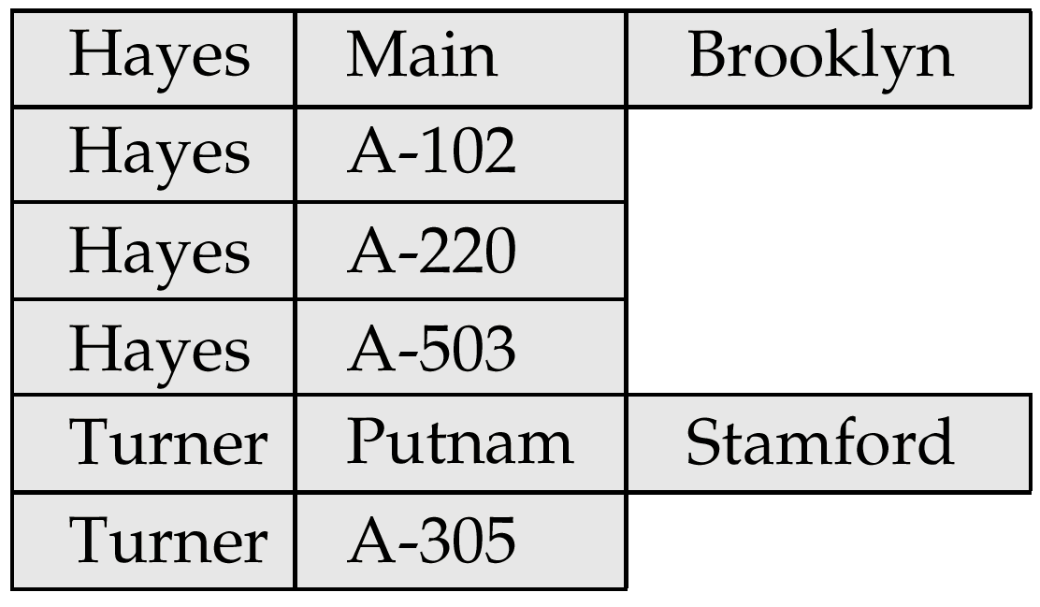
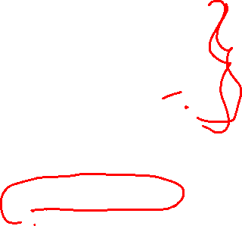
Clustering File Organization
Simple file structure stores each relation in a separate file
Can instead store several relations in one file using a clustering file organization
E.g., clustering organization of customer and depositor:
good for queries involving depositor customer, and for queries involving one single customer and his accounts
bad for queries involving only customer
results in variable size records

Slide 18
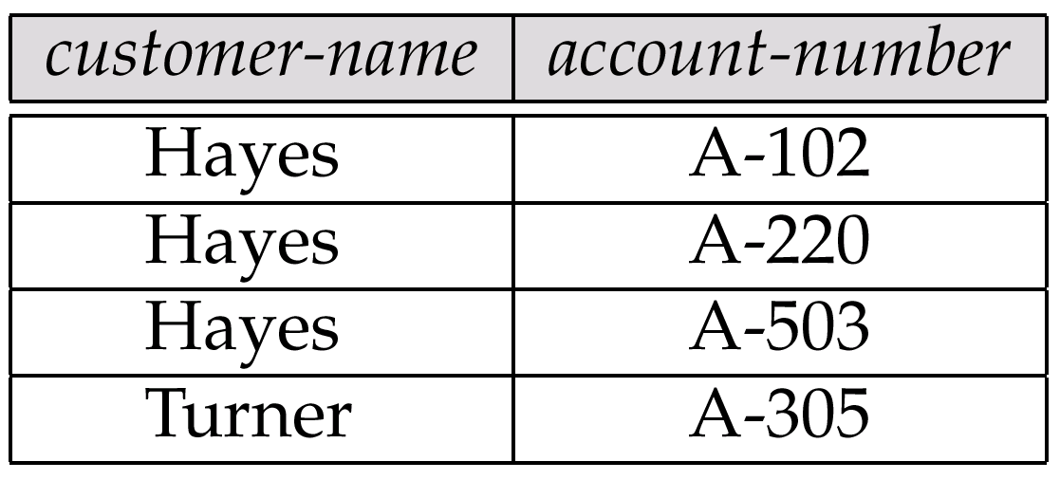
The depositor Relation

Slide 19
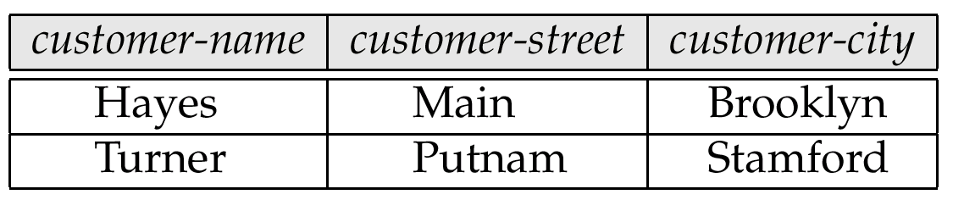
The customer Relation

Slide 20
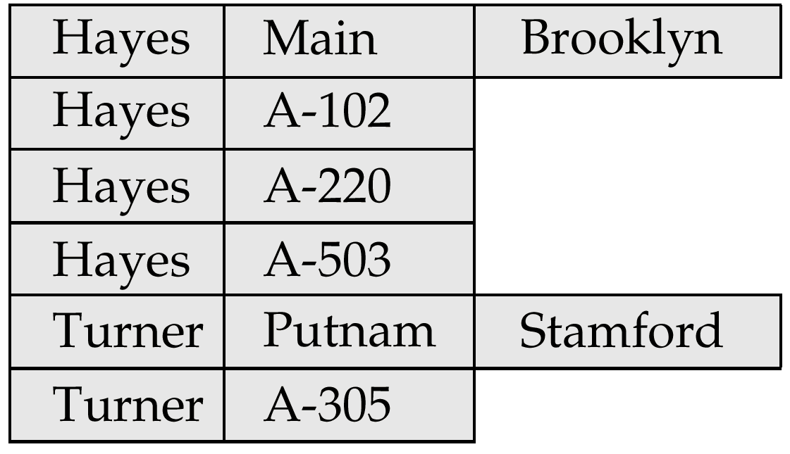

Clustering File Structure

Slide 21
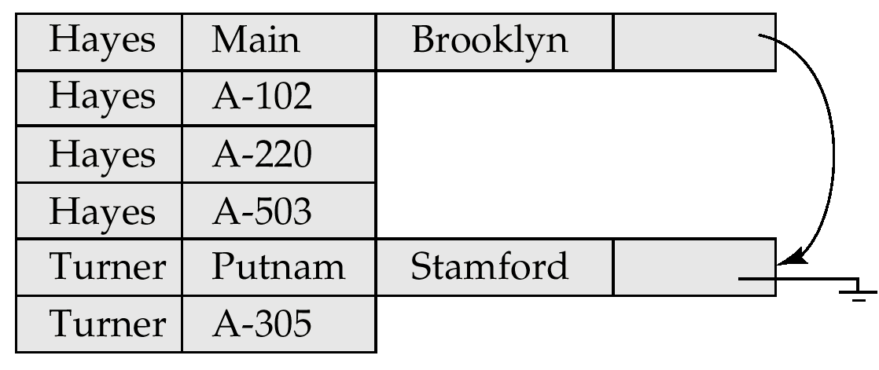
Clustering File Structure With Pointer Chains

Slide 22

Thank You!!!

